Slide 1
Neighborhood Segmentation Cambridge MA
Michael McCormick
Applied Data Science Capstone Presentation
May 19th, 2019

Slide 2
Cambridge
5th most populous city in Massachusetts
13 Neighborhoods
6 main squares of commercial activity
Problem: Based on neighborhoods and local venues, how do the neighborhoods fit together?
Useful for business owners, investors, and potential tenants

Slide 3
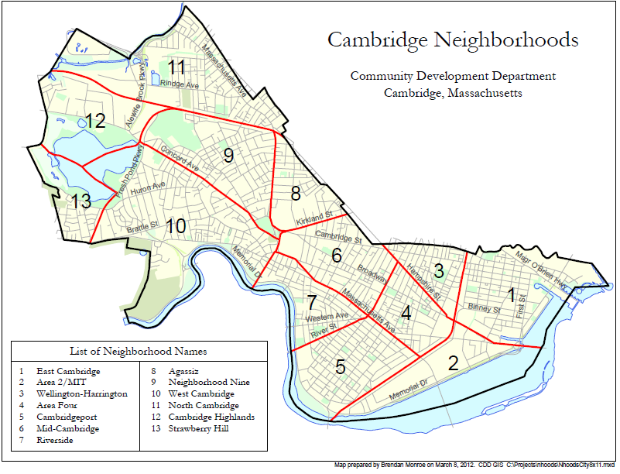
Data Set
Neighborhood mapping based on the Community Development Department of the city of Cambridge:
http://www.cambridgema.gov/~/media/Files/CDD/Maps/Neighborhood/cddmap_nhood_index.ashx
Using neighborhood names above, Google map search function was used to gather the center coordinates for each neighborhood.
Combining the neighborhoods and Longitude and latitude into one data set, a .json file for all of Cambridge was produced.
Combining this data with the Forsquare API to get the most common venues and attractions within each neighborhood

Slide 4
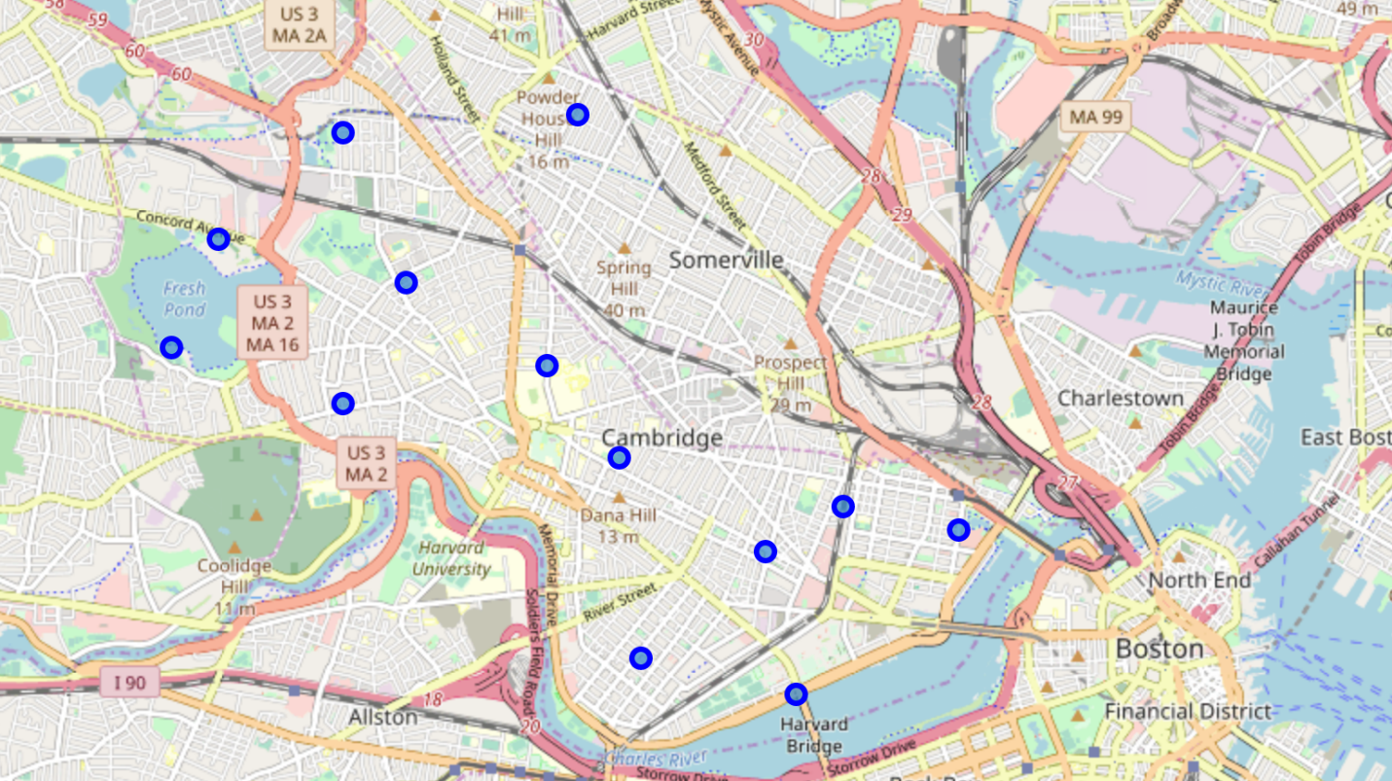
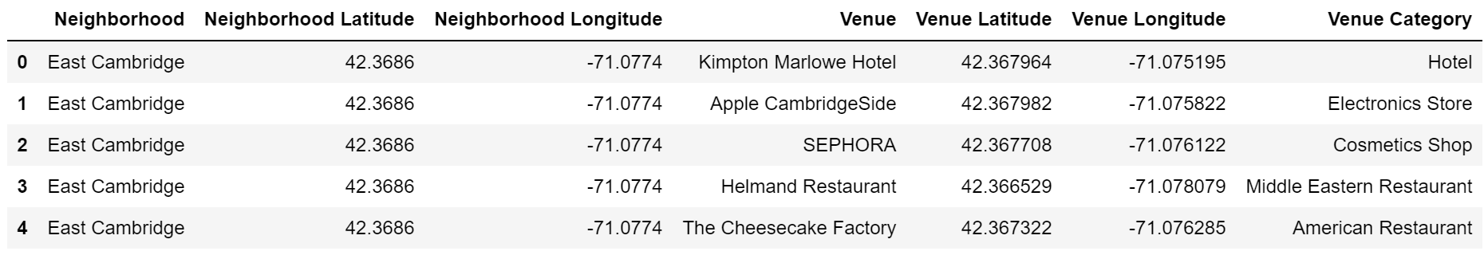
Methodology
Mapped Neighborhoods
Used Forsquare API to pull in venue data based on coordinates

Slide 5
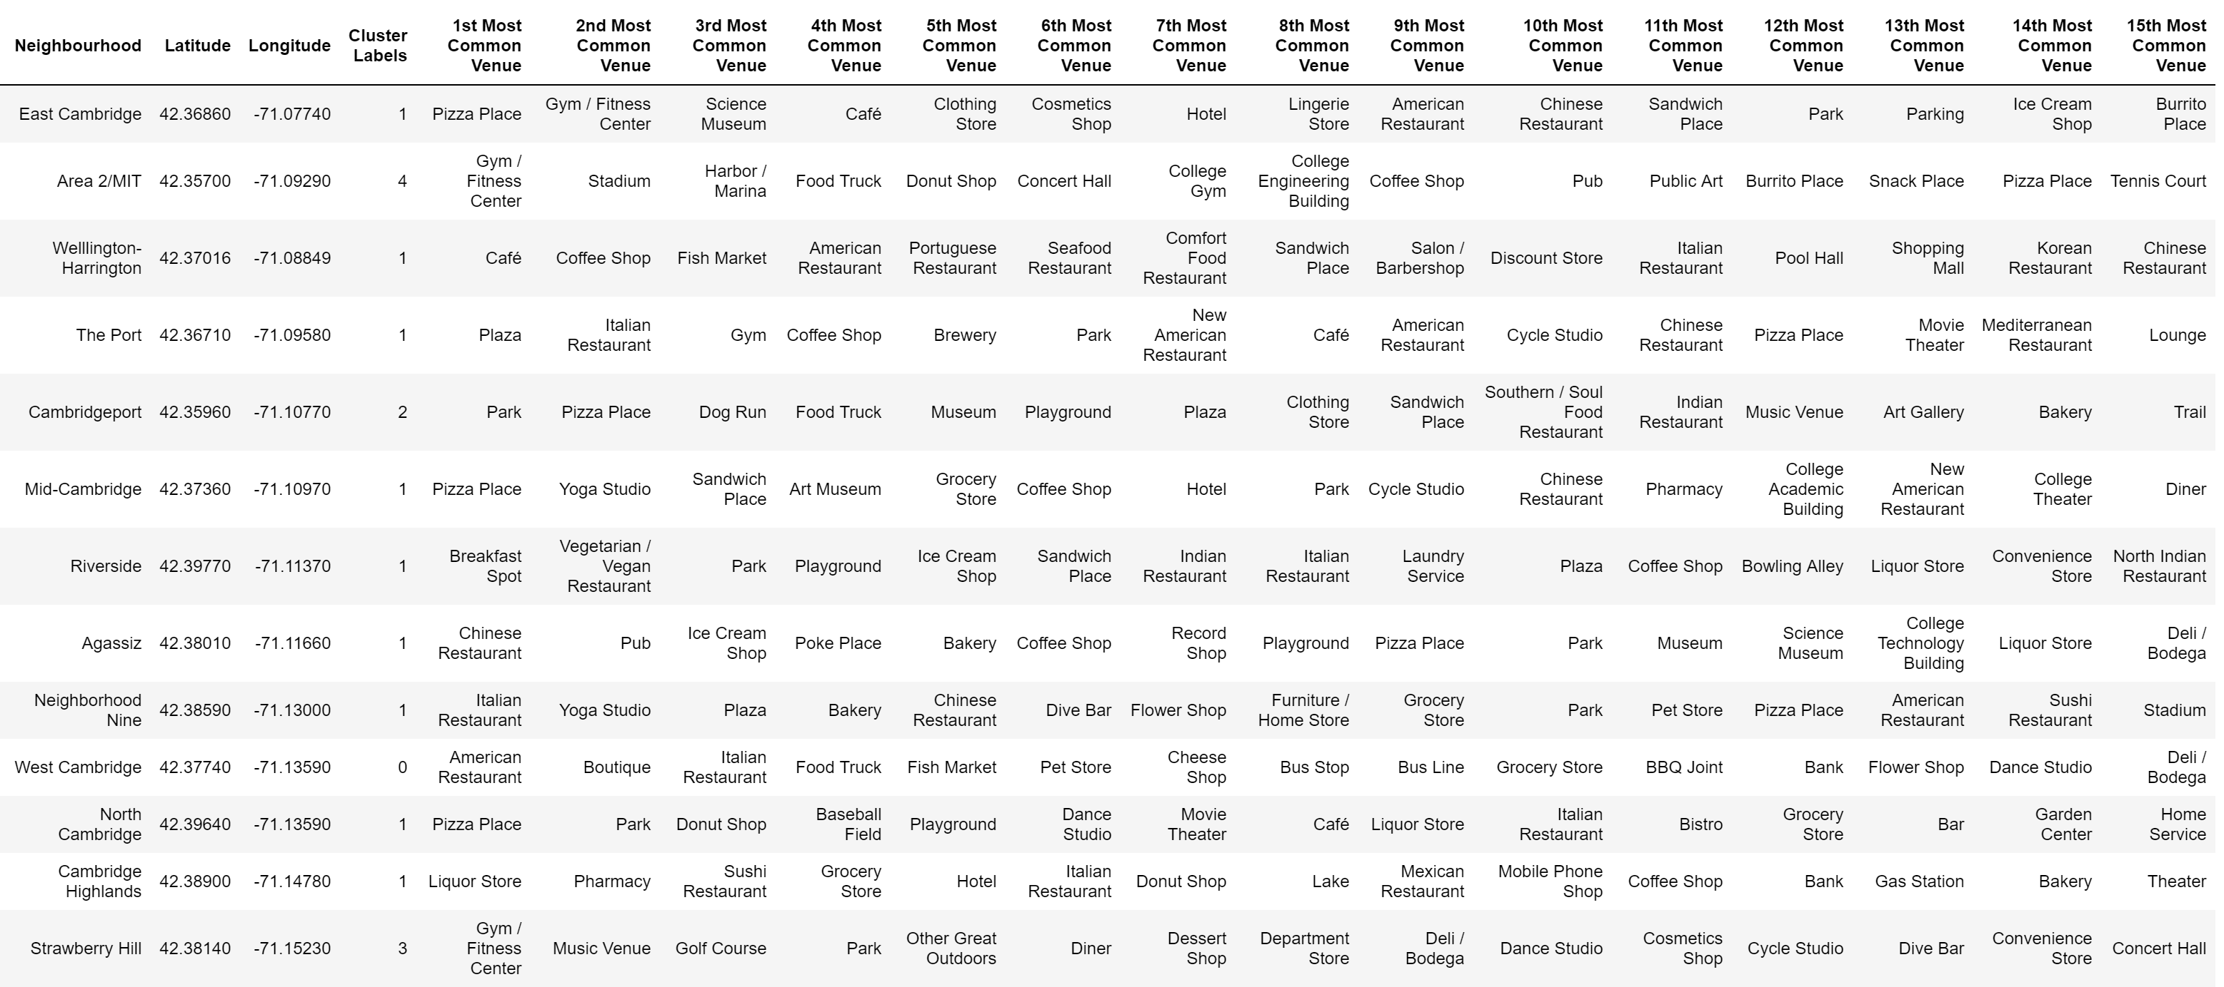
Methodology – cont’d
Combine Venues and Neighborhoods
K-means algorithm
5 clusters designated

Slide 6
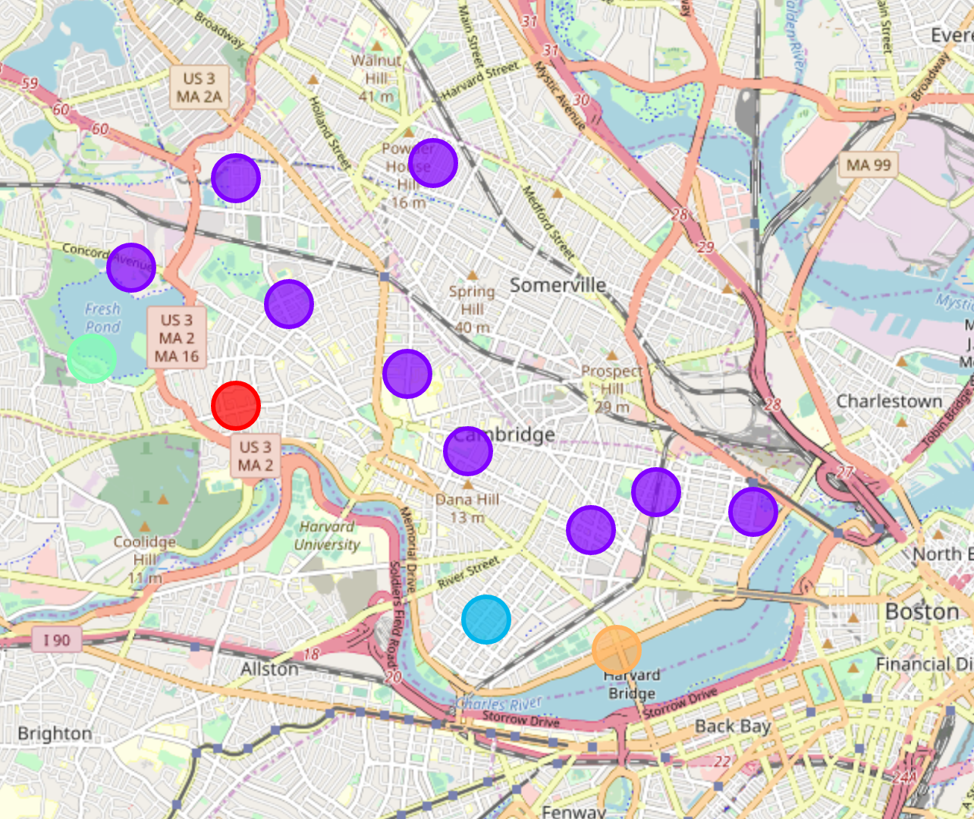
Cluster Results
5 Clusters based on top 15 Venues per Forsquare API

Slide 7
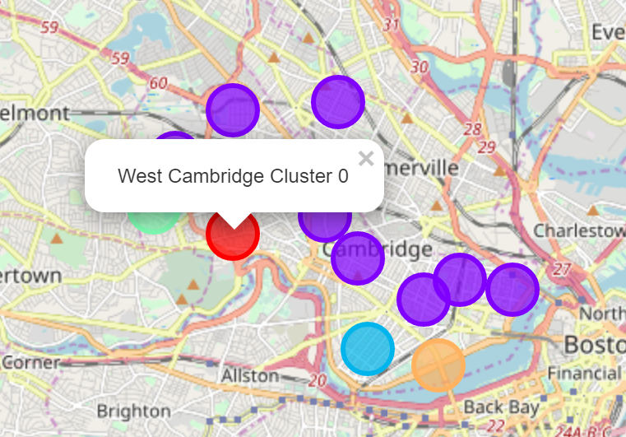

Cluster 0 Results
West Cambridge Cluster
While 2 out of 3 top venues are restaurants, most common venues are stores so area has more commercial appeal in small stores or services.
This would be used by investors or small business owners who are looking for investment opportunities or opening up new stores as it appears to be a popular store front area.

Slide 8
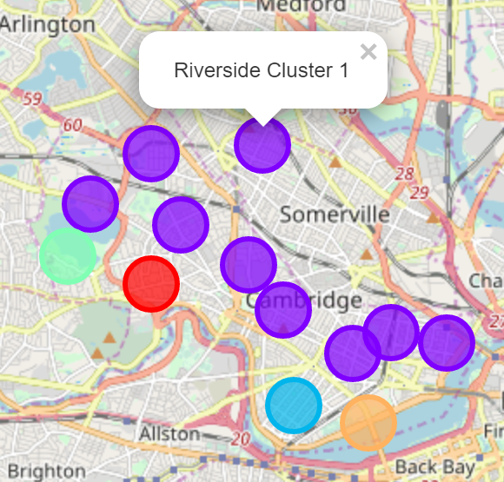
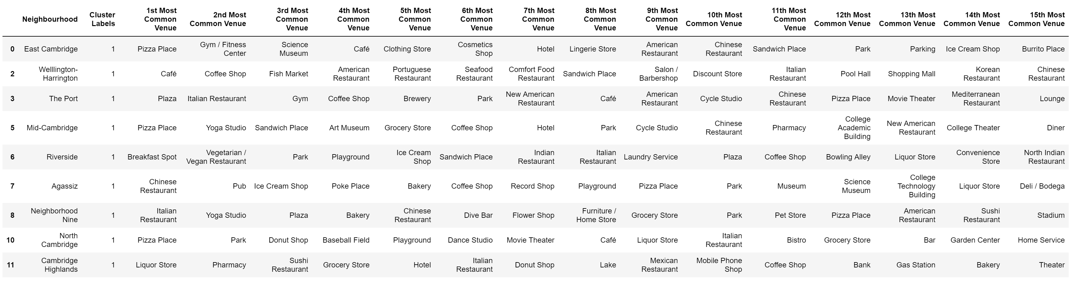
Cluster 1 Results
Dominate cluster of all segments as it encompasses 9 out of 13 neighborhoods, a 69% concentration of neighborhoods.
Most common venue is restaurants, particularly Pizza places.
The second most common venue across the cluster is parks so a good amount of outdoor area.
This would be important to individuals looking to move into the area that enjoy outdoors.
Cafes and bakeries are also popular which would be of interest to investors and small business owners as it might have over saturation of this type of venue.

Slide 9
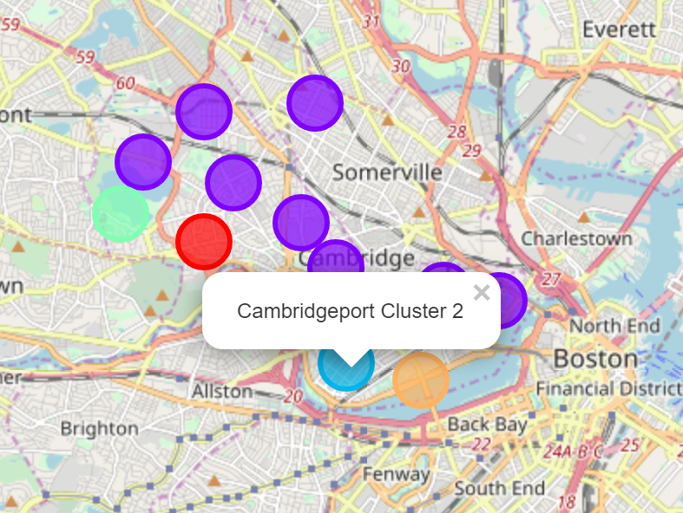

Cluster 2 Results
Cambridgeport
Highest venues are parks and dog run so outdoor space for potential renters or homebuyers in the area.
Pizza place is the second venue and a few other restaurant or food service venues.
Potential for investors or small business owners looking to open a new food related venue as there appears to not be an over saturation of this type.

Slide 10
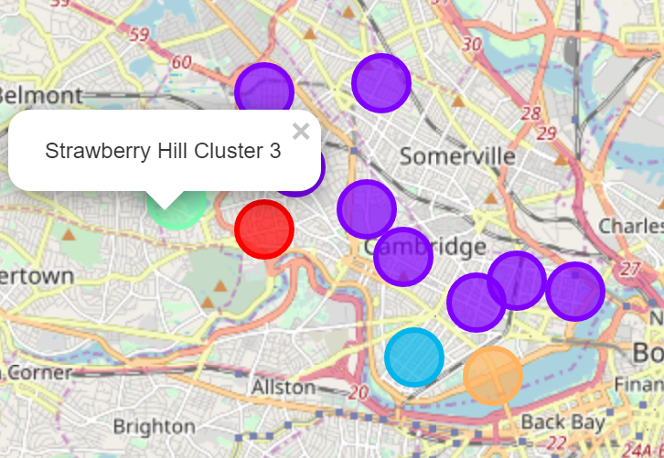

Cluster 3 Results
Strawberry Hill
Highest venues are parks and dog run so outdoor space for potential renters or homebuyers in the area.
Pizza place is the second venue and a few other restaurant or food service venues.
Potential for investors or small business owners looking to open a new food related venue as there appears to not be an over saturation of this type.

Slide 11
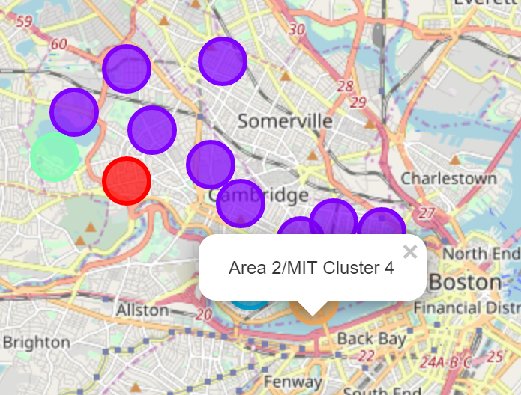
Cluster 4 Results
Area 2/MIT
Area is dominated by MIT college so most venues are related to the school or student life.
Potential investment opportunity with the school or small business that caters to college students.

Slide 12
Conclusion
Although the data set and clustering would be enough for most investors or individuals looking for an area to live in, to improve the analysis more data would be required.
The coordinates of each neighborhood could be focused more to the individual areas or blocks in order to change the level of venue clustering.
Addition of following data sets:
Population densities,
Average sales price of products,
Median income
Tax detail to help further distinguish the data set.
This improved analysis could not only just be used by investors but city planning or other government entities.

